Slide 1

Eagle Scout Project
Carson Kramer
Troop 180
1

Slide 2

Description
Kids corner and refurbishment of multipurpose room
Interactive TV setup (iPad + TV)
Allows parents to not be distracted while searching for jobs
Children learn from Sesame Street in Communities (Homelessness Curriculum)
Adult area with job tip posters and new seating, complement the computer area
2

Slide 3
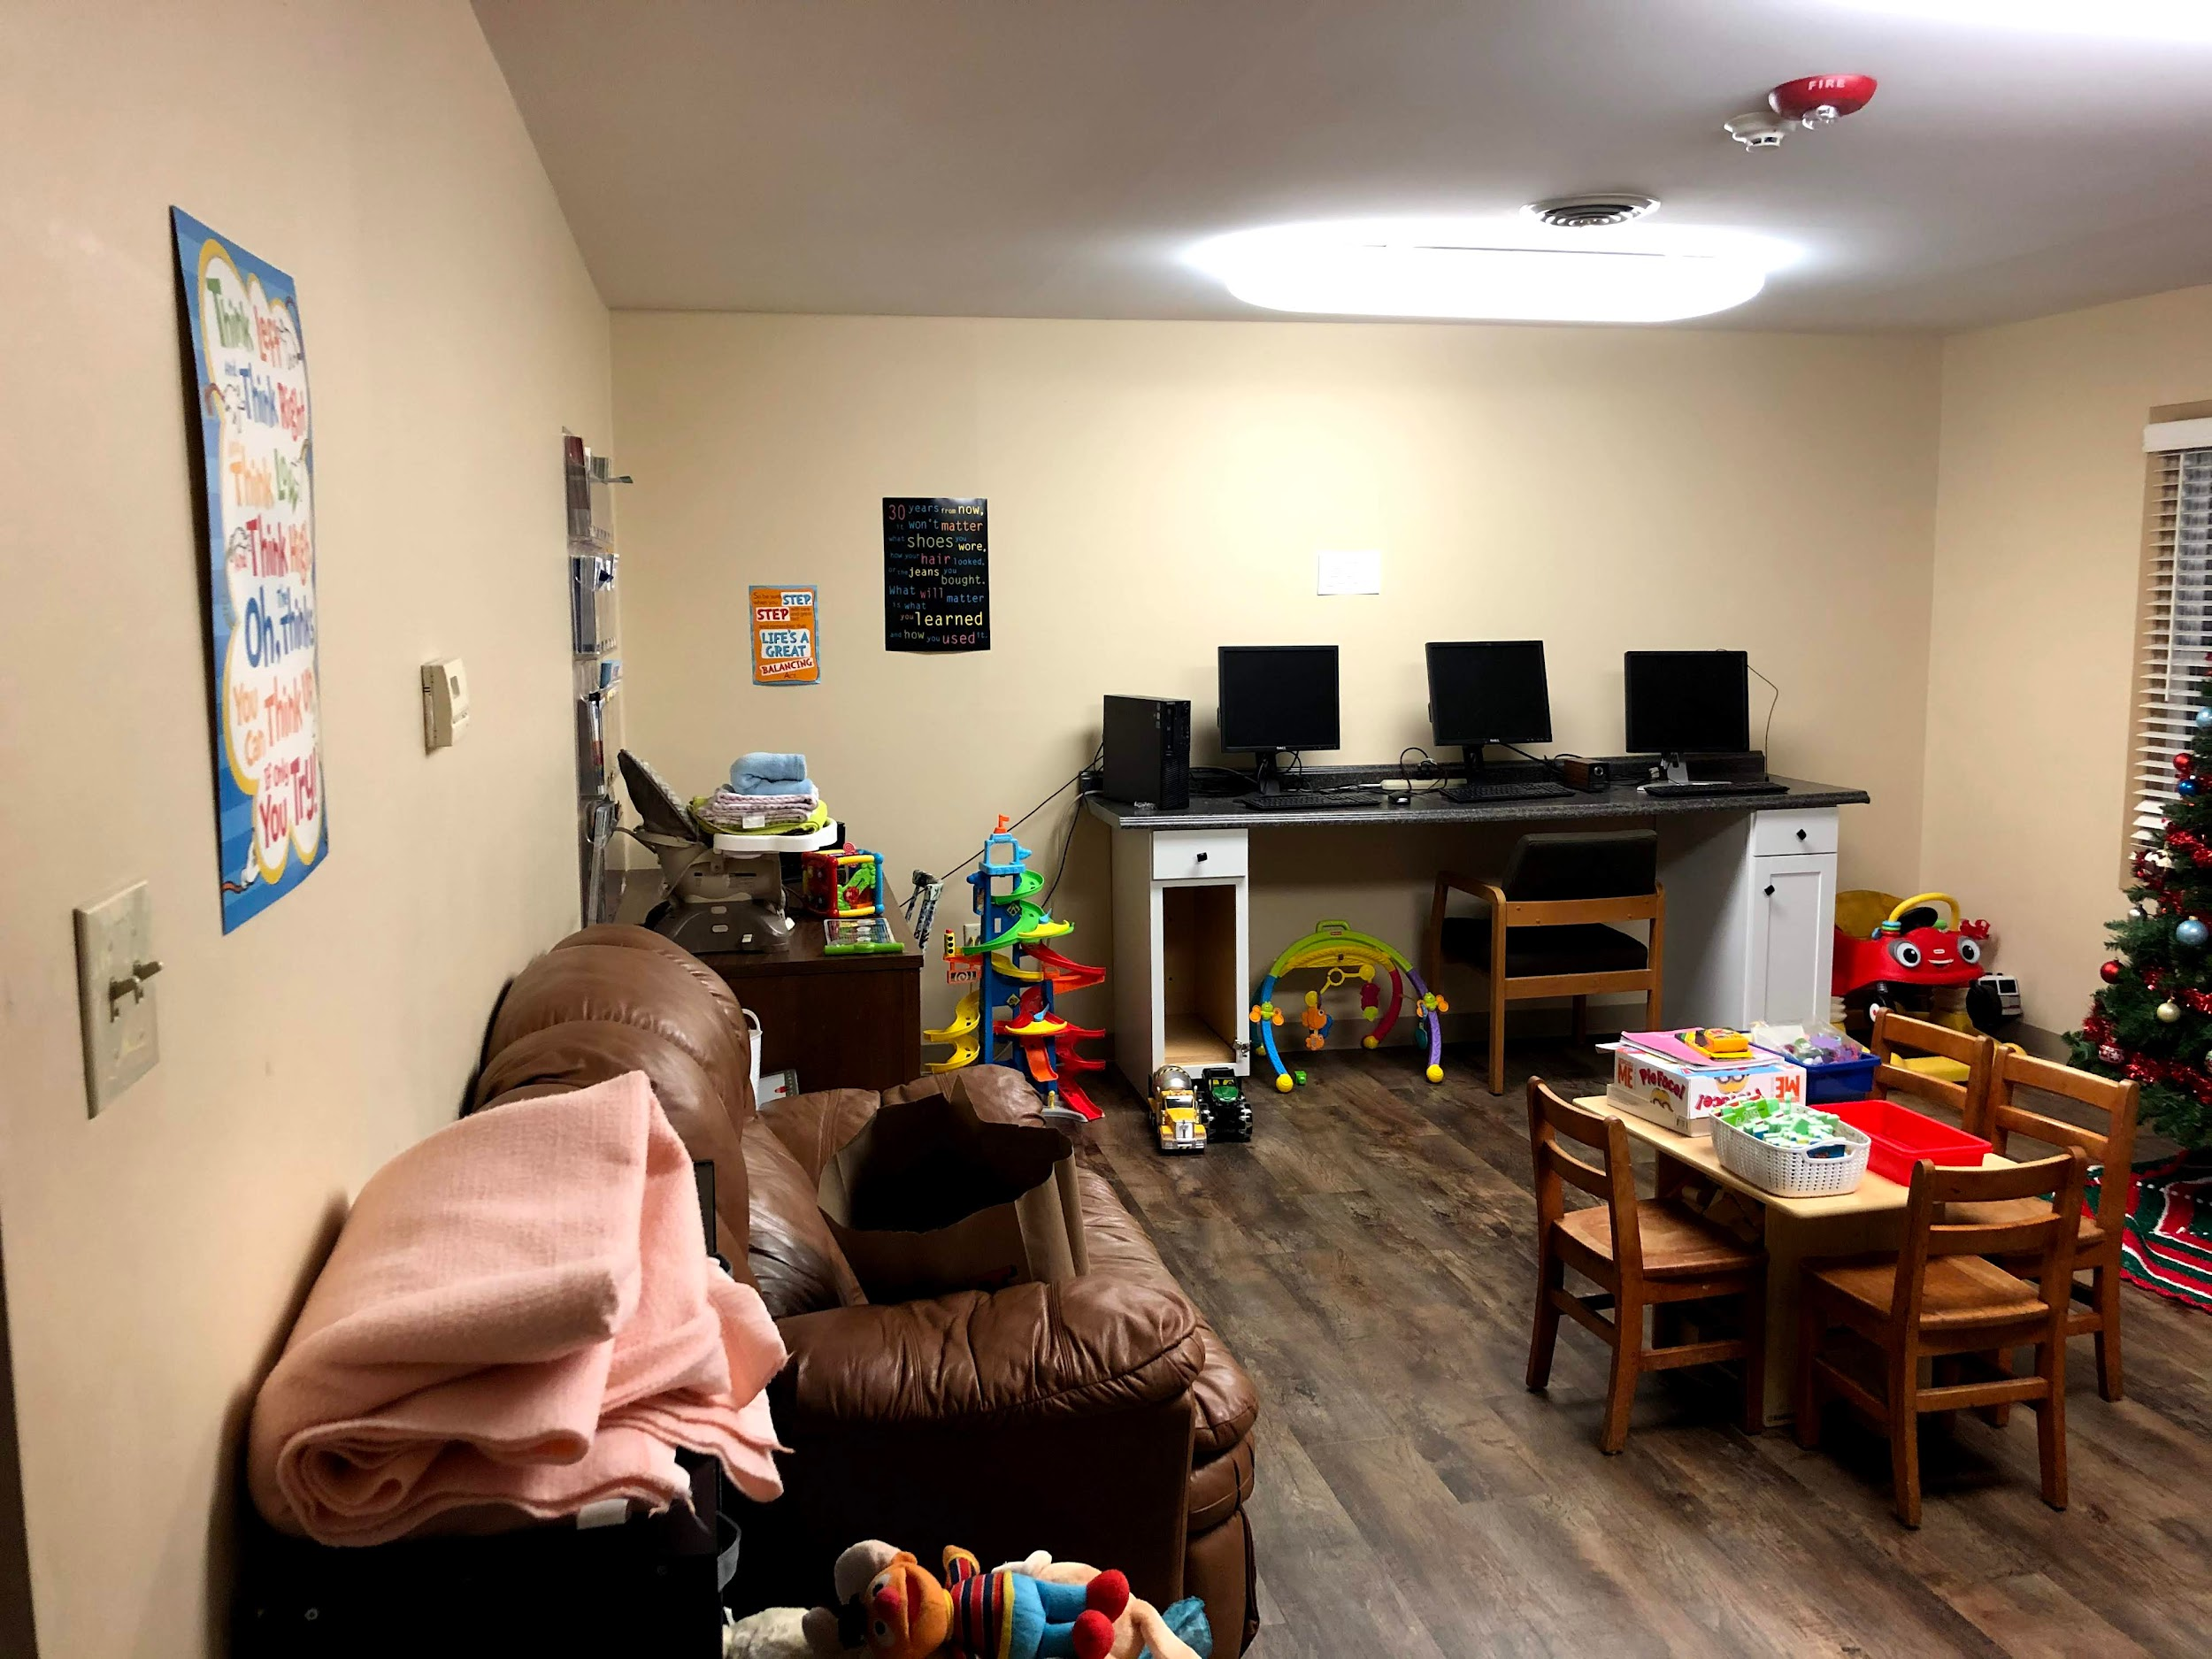
3

Slide 4
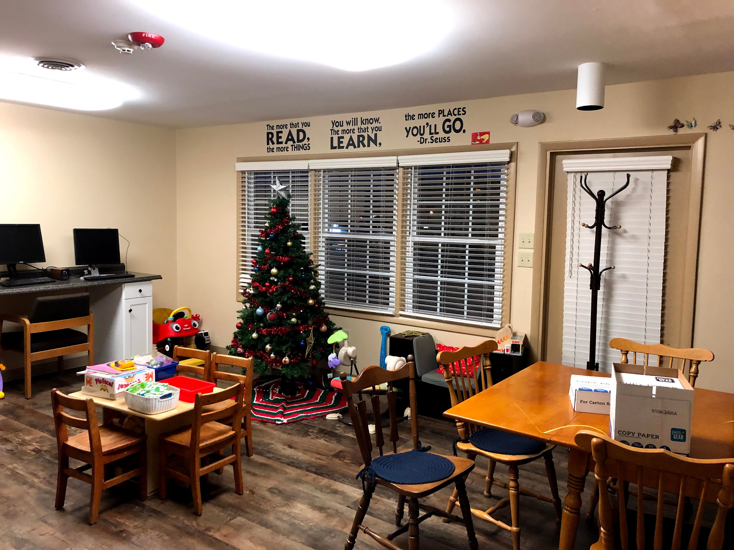
4

Slide 5
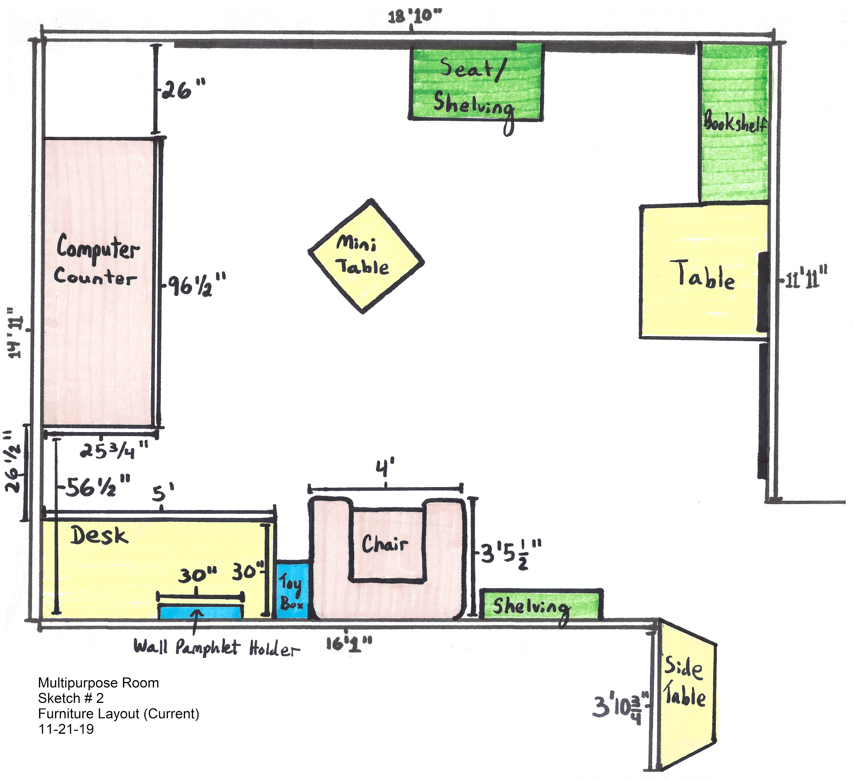
Before:
(Current)
5

Slide 6
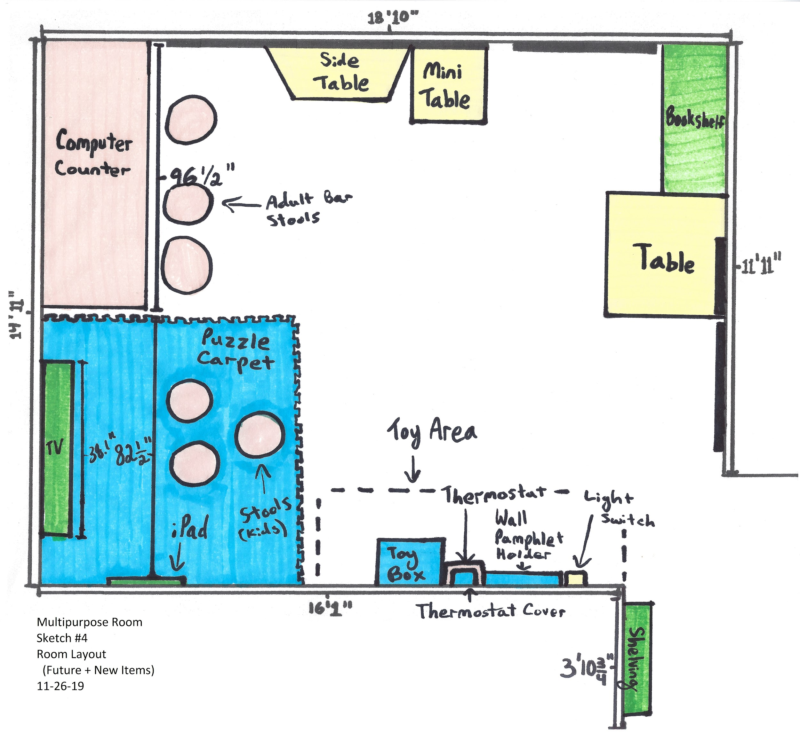
After:
(Future)
6

Slide 7

Components
TV & iPad
Puzzle Carpet
Kid Stools
Thermostat Cover
Computer Counter Bar Stools
Cabinet Fixes
Furniture Rearrangement
7

Slide 8
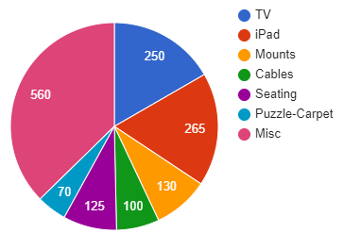
Approximate Budget
TV - $250
iPad - $265
iPad Wall Mount - $130
Cables - $100
Seating (Adult & Children) - $125
Puzzle Carpet - $70
Miscellaneous - $560
Total - $1,500
8

Slide 9

Tentative Timeline
Finished By:
End of February - Finished Proposal and Approval Process
End of March - Finished Fundraising
End of April - Finished Project Workdays
End of May - Finished Paperwork and Formalized
9

Slide 10

Open Questions?
10

